Slide 1

Exercise 4 Activity

Slide 2
Exercise 4
Q1
Approaches:
Pros
Cons
Q2
Preferred approach:
Best practice criteria?
Assumptions?

Slide 3
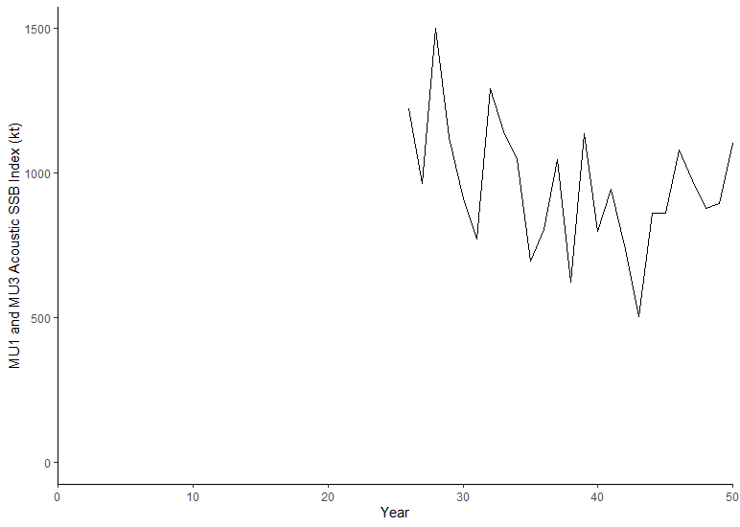
Exercise 4
Q3
Add plot here from R
Q4
Stock status?
How is uncertainty in stock status taken into account?

Slide 4
Exercise 4 Presentation Slide (to share at the workshop tomorrow)

Slide 5
Break Out Group Add Number
Stock status indicator:
Stock status:
Add plot here
Submit all slides to Tim.Barrett@dfo-mpo.gc.ca when complete

